Slide 1
Recursive Definitions
Computer Science, Purdue University
Copyright McGraw Hill, Rosen, Discrete Mathematics and its Applications

Slide 2
Recursive Definitions
Recursively Defined Functions
Definition: A recursive or inductive definition of a function consists of two steps.
BASIS STEP: Specify the value of the function at zero.
RECURSIVE STEP: Give a rule for finding its value at an integer from its values at smaller integers.
A function f(n) is the same as a sequence a₀, a₁, … , where f(i) = a_{i}.
Computer Science, Purdue University

Slide 3
Recursive Definitions
Recursively Defined Functions
Example: Suppose f is defined by:
f(0) = 3,
f(n + 1) = 2f(n) + 3
Find f(1), f(2), f(3), f(4)
Solution:
f(1) = 2f(0) + 3 = 2∙3 + 3 = 9
f(2) = 2f(1)+ 3 = 2∙9 + 3 = 21
f(3) = 2f(2) + 3 = 2∙21 + 3 = 45
f(4) = 2f(3) + 3 = 2∙45 + 3 = 93
Example: Give a recursive definition of the factorial function n!:
Solution:
f(0) = 1
f(n + 1) = (n + 1)∙ f(n)
Computer Science, Purdue University

Slide 4
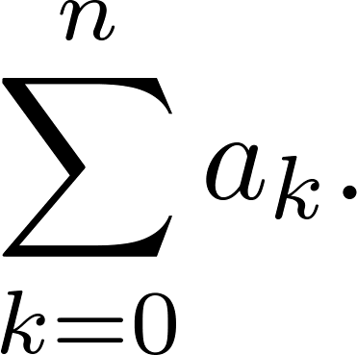
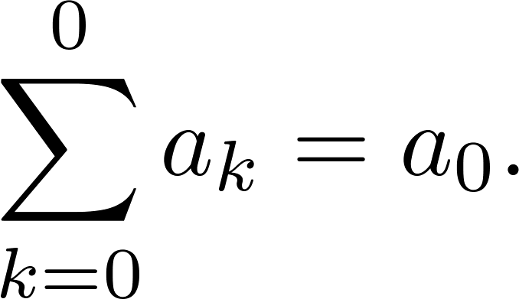
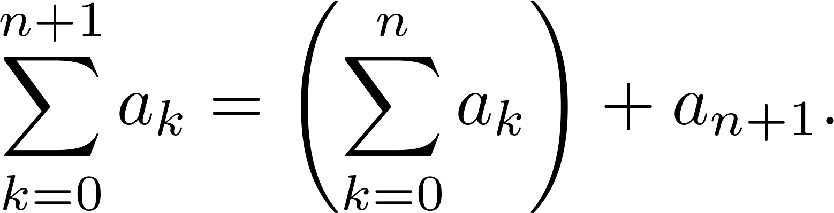
Recursive Definitions
Recursively Defined Functions
Example: Give a recursive definition of:
Solution: The first part of the definition is
The second part is
Computer Science, Purdue University

Slide 5
Recursive Definitions
Fibonacci Numbers
Example : The Fibonacci numbers are defined as follows:
f₀ = 0
f₁ = 1
f_{n} = f_{n−1} + f_{n−2}
Find f₂, f₃ , f₄ , f₅ .
f₂ = f₁ + f₀ = 1 + 0 = 1
f₃ = f₂ + f₁ = 1 + 1 = 2
f₄ = f₃ + f₂ = 2 + 1 = 3
f₅ = f₄ + f₃ = 3 + 2 = 5
Computer Science, Purdue University

Slide 6
Recursive Definitions
Fibonacci Numbers
Example 4: Show that whenever n ≥ 3, f_{n} > α^{n − 2}, where α = (1 + √5)/2.
Solution: Let P(n) be the statement f_{n} > α^{n−2} . Use strong induction to show that P(n) is true whenever n ≥ 3.
BASIS STEP: P(3) holds since α < 2 = f₃
P(4) holds since α² = (3 + √5)/2 < 3 = f₄ .
INDUCTIVE STEP: Assume that P(j) holds, i.e., f_{j} > α^{j−2} for all integers j with
3 ≤ j ≤ k, where k ≥ 4. We must show that P(k + 1) holds, i.e., f_{k+1} > α^{k−1} .
Computer Science, Purdue University
⁻² .

Slide 7
Recursive Definitions
Fibonacci Numbers
Since α² = α + 1 (because α is a solution of x² − x − 1 = 0),
By the inductive hypothesis, because k ≥ 4 we have
Therefore, it follows that
Hence, P(k + 1) is true.
α^{k−1} = α² ∙ α^{k−3} = ( α + 1) ∙α^{k−3} = α ∙α^{k−3}+ 1 ∙α^{k−3} = α^{k−2} + α^{k−3}
f_{k−1} > α^{k−3}, f_{k} > α^{k−2}.
f_{k+1} = f_{k} + f_{k−1} > α^{k−2} + α^{k−3} = α^{k−1}.
Computer Science, Purdue University
⁻² .

Slide 8
Recursive Definitions
Recursively Defined Sets and Structures
Recursive definitions of sets have two parts:
The basis step specifies an initial collection of elements.
The recursive step gives the rules for forming new elements in the set from those already known to be in the set.
Sometimes the recursive definition has an exclusion rule, which specifies that the set contains nothing other than those elements specified in the basis step and generated by applications of the rules in the recursive step.
We will always assume that the exclusion rule holds, even if it is not explicitly mentioned.
Computer Science, Purdue University
⁻² .

Slide 9
Recursive Definitions
Recursively Defined Sets and Structures
Example: Subset of Integers S:
BASIS STEP: 3 ∊ S.
RECURSIVE STEP: If x ∊ S and y ∊ S, then x + y is in S.
Initially 3 is in S, then 3 + 3 = 6, then 3 + 6 = 9, etc.
Example: The natural numbers N.
BASIS STEP: 0 ∊ N.
RECURSIVE STEP: If n is in N, then n + 1 is in N.
Initially 0 is in S, then 0 + 1 = 1, then 1 + 1 = 2, etc.
Computer Science, Purdue University
⁻² .

Slide 10
Recursive Definitions
Recursively Defined Strings
Definition: The set Σ* of strings over the alphabet Σ:
BASIS STEP: λ ∊ Σ* (λ is the empty string)
RECURSIVE STEP: If w is in Σ* and x is in Σ, then wx ∈ Σ*.
Example: If Σ = {0,1}, the strings in Σ* are the set of all bit strings, λ,0,1, 00,01,10, 11, etc.
Example: If Σ = {a,b}, show that aab is in Σ*.
Since λ ∊ Σ* and a ∊ Σ, a ∊ Σ*.
Since a ∊ Σ* and a ∊ Σ, aa ∊ Σ*.
Since aa ∊ Σ* and b ∊ Σ, aab ∊ Σ*.
Computer Science, Purdue University
⁻² .

Slide 11
Recursive Definitions
String Concatenation
Definition: Two strings can be combined via the operation of concatenation. Let Σ be a set of symbols and Σ* be the set of strings formed from the symbols in Σ. We can define the concatenation of two strings, denoted by ∙, recursively as follows.
BASIS STEP: If w ∈ Σ*, then w ∙ λ= w.
RECURSIVE STEP: If w₁ ∈ Σ* and w₂ ∈ Σ* and x ∈ Σ, then w₁ ∙ (w₂ x)= (w₁ ∙ w₂)x.
Often w₁ ∙ w₂ is written as w₁ w₂.
If w₁ = abra and w₂ = cadabra, the concatenation w₁ w₂ = abracadabra.
Computer Science, Purdue University
⁻² .

Slide 12
Recursive Definitions
String Length
Example: Give a recursive definition of l(w), the length of the string w.
Solution: The length of a string can be recursively defined by:
l(λ) = 0;
l(wx) = l(w) + 1 if w ∊ Σ* and x ∊ Σ.
Computer Science, Purdue University
⁻² .

Slide 13
Recursive Definitions
Balanced Parenthesis
Example: Give a recursive definition of the set of balanced parentheses P.
Solution:
BASIS STEP: () ∊ P
RECURSIVE STEP: If w ∊ P, then () w ∊ P, (w) ∊ P and w () ∊ P.
Show that (() ()) is in P.
Why is ))(() not in P?
Computer Science, Purdue University
⁻² .

Slide 14
Recursive Definitions
Well Formed Formulae in Propositional Logic
Definition: The set of well-formed formulae in propositional logic involving T, F, propositional variables, and operators from the set {¬,∧,∨,→,↔}.
BASIS STEP: T,F, and s, where s is a propositional variable, are well-formed formulae.
RECURSIVE STEP: If E and F are well formed formulae, then (¬ E), (E ∧ F), (E ∨ F), (E → F), (E ↔ F), are well-formed formulae.
Examples: ((p ∨q) → (q ∧ F)) is a well-formed formula.
pq ∧ is not a well formed formula.
Computer Science, Purdue University
⁻² .

Slide 15
Recursive Definitions
Rooted Trees
Definition: The set of rooted trees, where a rooted tree consists of a set of vertices containing a distinguished vertex called the root, and edges connecting these vertices, can be defined recursively by these steps:
BASIS STEP: A single vertex r is a rooted tree.
RECURSIVE STEP: Suppose that T₁, T₂, …,T_{n} are disjoint rooted trees with roots r₁, r₂,…,r_{n}, respectively. Then the graph formed by starting with a root r, which is not in any of the rooted trees T₁, T₂, …,T_{n}, and adding an edge from r to each of the vertices r₁, r₂,…,r_{n}, is also a rooted tree.
Computer Science, Purdue University
⁻² .

Slide 16
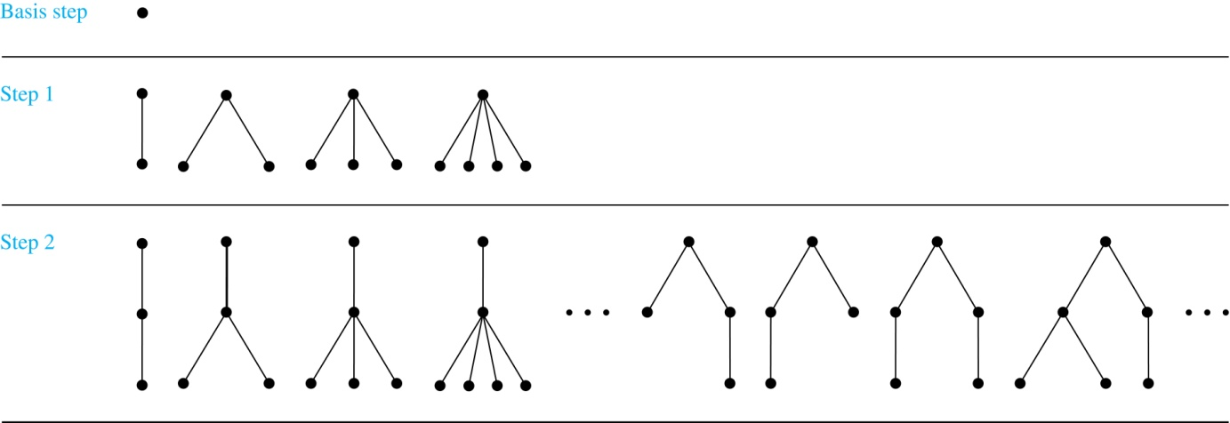
Recursive Definitions
Rooted Trees
Computer Science, Purdue University
⁻² .

Slide 17
Recursive Definitions
Full Binary Trees
Definition: The set of full binary trees can be defined recursively by these steps.
BASIS STEP: There is a full binary tree consisting of only a single vertex r.
RECURSIVE STEP: If T₁ and T₂ are disjoint full binary trees, there is a full binary tree, denoted by T₁∙T₂, consisting of a root r together with edges connecting the root to each of the roots of the left subtree T₁ and the right subtree T₂.
Computer Science, Purdue University
⁻² .

Slide 18
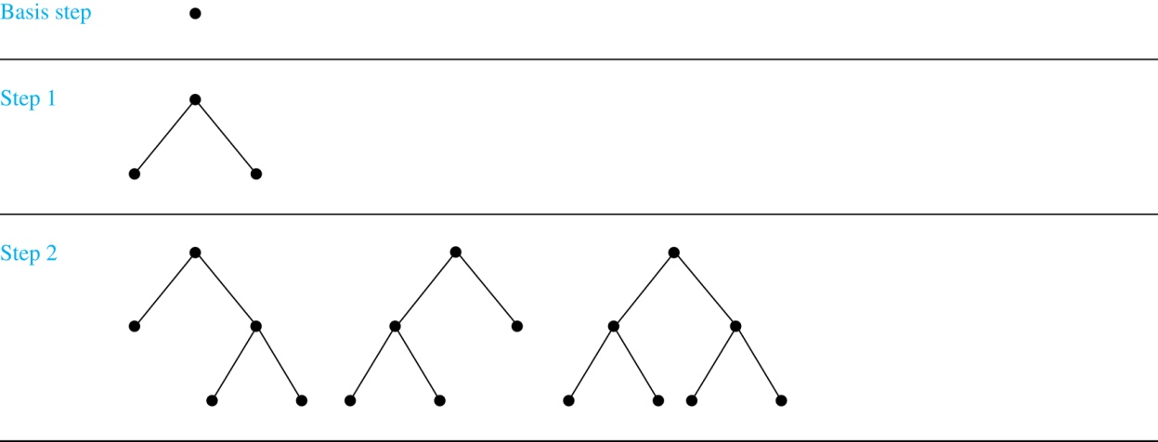
Recursive Definitions
Full Binary Trees
Computer Science, Purdue University
⁻² .

Slide 19
Thank You

